Slide 1

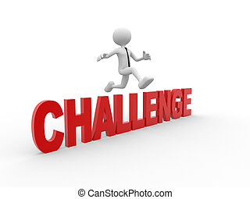

CONSTRAINTS AND CHALLENGES FOR THE GLOBAL MANAGER
UNIT 2

Slide 2
LEARNING OUTCOMES
Contrast the actions of managers according to the omnipotent and symbolic views.
Describe the constraints and challenges facing managers in today’s external environment.
Discuss the characteristics and importance of organizational culture.
Describe current issues in organizational culture.

Slide 3
THE MANAGER: OMNIPOTENT OR SYMBOLIC?
Omnipotent View of Management - the view that managers are directly responsible for an organization’s success or failure.
Symbolic view of Management - the view that much of an organization’s success or failure is due to external forces outside managers’ control.
Notes:
How much difference does a manager make in how an organization performs? The dominant view in management theory and society in general is that managers are
directly responsible for an organization’s success or failure. We call this perspective the omnipotent view of management. In contrast, others have argued that much
of an organization’s success or failure is due to external forces outside managers’ control. This perspective is called the symbolic view of management.

Slide 4

EXHIBIT 2-1 CONSTRAINTS ON MANAGERIAL DISCRETION
Notes:
In reality, managers are neither all-powerful nor helpless. But their decisions and actions are constrained. As you can see in Exhibit 2-1, external constraints come from
the organization’s environment and internal constraints come from the organization’s culture.

Slide 5
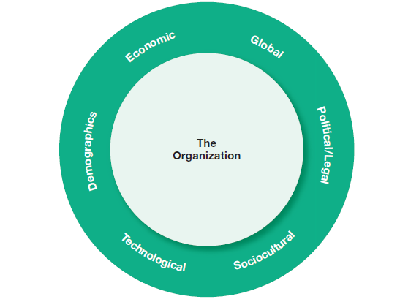
EXHIBIT 2-2 COMPONENTS OF EXTERNAL ENVIRONMENT
Notes:
The term external environment refers to factors and forces outside the organization that affect its performance. As shown in Exhibit 2-2, it includes several different
components.
The economic component encompasses factors such as interest rates, inflation, changes in disposable income, stock market fluctuations, and business
cycle stages.
The demographic component is concerned with trends in population characteristics such as age, race, gender, education level, geographic location, income, and family composition. The political/legal component looks at federal, state, and local laws as well as global laws and laws of other countries. It also includes a country’s political conditions and stability.
The sociocultural component is concerned with societal and cultural factors such as values, attitudes, trends, traditions, lifestyles, beliefs, tastes, and patterns of behavior.
The technological component is concerned with scientific or industrial innovations.
And the global component encompasses those issues associated with globalization and a world economy

Slide 6
THE ECONOMIC ENVIRONMENT
Global economic recession - began with US home mortgage and soon affected businesses as credit markets collapsed. It did not take long for these economic trouble to spread worldwide.
Economic inequality - As economic growth has languished and sputtered, social discontent over growing income gaps has increased.
Notes:
began with turmoil in home mortgage markets in the United States when many homeowners found themselves unable to make their payments. The problems soon
affected businesses as credit markets collapsed. All of a sudden, credit was no longer readily available to fund business activities. It didn’t take long for these economic
troubles to spread worldwide.
As economic growth has languished and sputtered, and as people’s belief that anyone could grab hold of an opportunity and have a decent shot at prosperity
has wavered, social discontent over growing income gaps has increased. The bottom line is that business leaders need to recognize how societal attitudes in the
economic context also may create constraints as they make decisions and manage their businesses

Slide 7
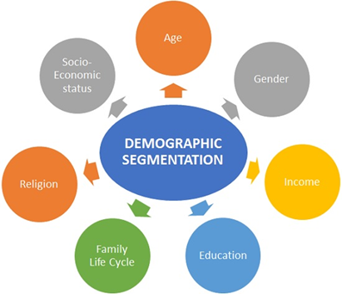
THE DEMOGRAPHIC ENVIRONMENT
Baby Boomers - those individuals born between 1946 and 1964
Gen Y (or the “Millennials”) - those individuals born between 1978 and 1994.
Post-Millennials - the youngest identified age group, basically teens and middle-schoolers
Notes:
Demographic age cohorts are important to our study of management because large numbers of people at certain stages in the life cycle can constrain decisions and actions taken by businesses, governments, educational institutions, and other organizations.

Slide 8

HOW THE EXTERNAL ENVIRONMENT AFFECTS MANAGERS
Jobs and employment - As external environmental conditions one of the most powerful constraints managers face is the impact of such changes on jobs and employment
Notes:
As any or all external environmental conditions (economic, demographic, technological, globalization, etc.) change, one of the most powerful constraints managers face is the impact of such changes on jobs and employment—both in poor conditions and in good conditions. The power of this constraint became painfully obvious during the recent global recession as millions of jobs were eliminated and unemployment rates rose to levels not seen in many years. Economists now predict that about a quarter of the 8.4 million jobs eliminated in the
United States during this most recent economic downturn won’t be coming back and will instead be replaced by other types of work in growing industries

Slide 9


HOW THE EXTERNAL ENVIRONMENT AFFECTS MANAGERS CONT’D
Environmental Uncertainty - the degree of change and complexity in an organization’s environment.
Environmental Complexity - the number of components in an organization’s environment and the extent of the organization’s knowledge about those components.

Slide 10
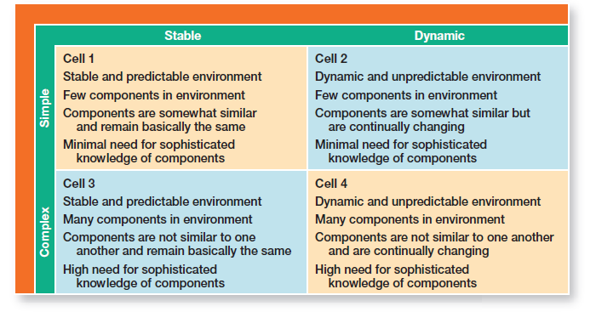
EXHIBIT 2-3 ENVIRONMENTAL UNCERTAINTY MATRIX

Slide 11
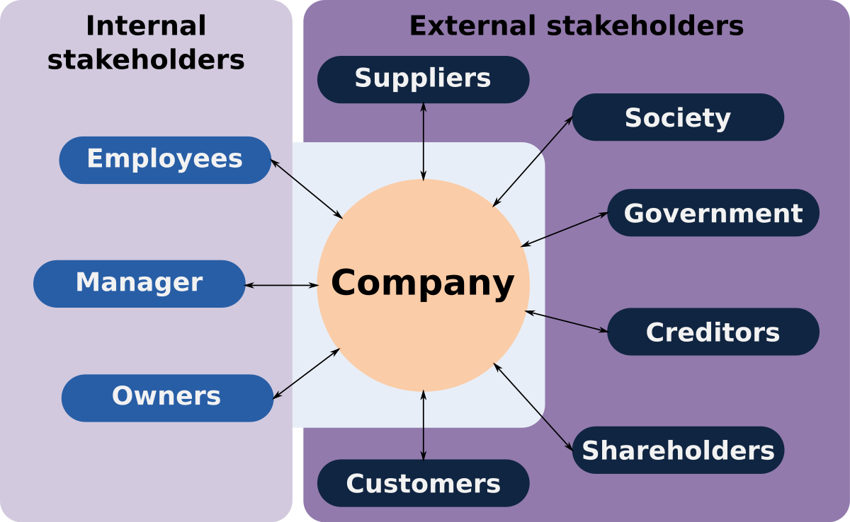
HOW THE EXTERNAL ENVIRONMENT AFFECTS MANAGERS CONT’D
Managing Stakeholder Relationships
Stakeholders are any constituencies in the organization’s environment affected by an organization’s decisions and actions. These groups have a stake in or are significantly influenced by what the organization does. In turn, these groups can influence the organization. The idea that organizations have stakeholders is now widely accepted by both management academics and practicing managers

Slide 12
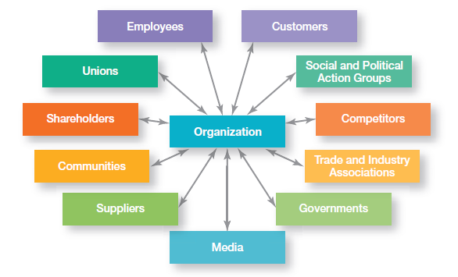
EXHIBIT 2-4 ORGANIZATIONAL STAKEHOLDERS

Slide 13

WHAT IS ORGANIZATIONAL CULTURE?
Organizational Culture - The shared values, principles, traditions, and ways of doing things that influence the way organizational members act.
Strong Cultures - Organizational cultures in which key values are intensely held and widely shared.

Slide 14
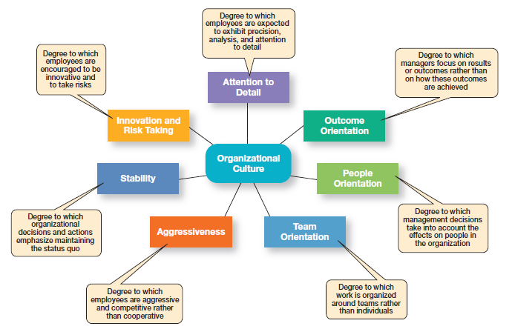
EXHIBIT 2-5 DIMENSIONS OF ORGANIZATIONAL CULTURE

Slide 15
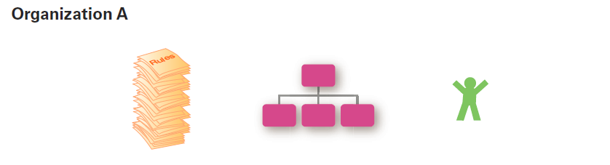
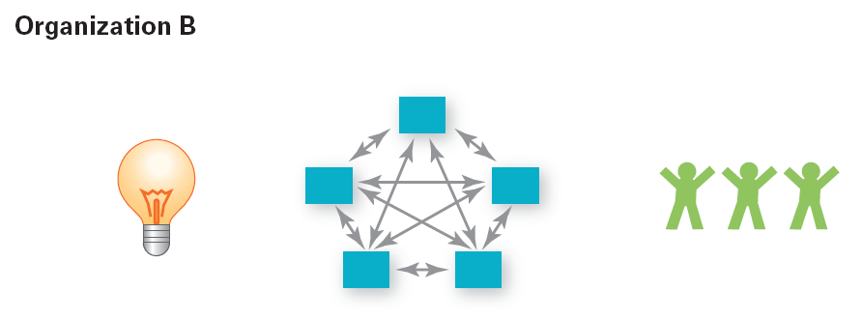
EXHIBIT 2-6 CONTRASTING ORGANIZATIONAL CULTURES
Notes:
In many organizations, one cultural dimension often is emphasized more than the others and essentially shapes the organization’s personality and the way organizational members work. For instance, at Sony Corporation, the focus is product innovation (innovation and risk taking). The company “lives and breathes” new product development and employees’ work behaviors support that goal.
In contrast, Southwest Airlines has made its employees a central part of its culture (people orientation). Exhibit 2-6 describes how the dimensions can create significantly
different cultures.
Exhibit 2-6 describes how the dimensions can create significantly different cultures.

Slide 16
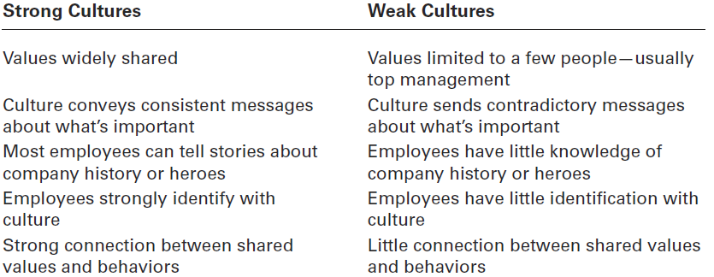
EXHIBIT 2-7 STRONG VERSUS WEAK CULTURES

Slide 17

WHERE DOES CULTURE COME FROM?
Organization founder
Vision and mission
Past practices
Top management behavior
Socialization - The process that helps employees adapt to the organization’s culture.
Notes:
The original source of the culture usually reflects the vision of the founders. Once the culture is in place, however, certain organizational practices help maintain it. For instance, during the employee selection process, managers typically judge job candidates not only on the job requirements, but also on how well they might fit into the organization. The actions of top managers also have a major impact on the organization’s culture. Through what they say and how they behave, top managers establish norms that filter down through the organization and can have a positive effect on employees’ behaviors. Finally, organizations help employees adapt to the culture through socialization, a process that helps new employees learn the organization’s way of doing things. For instance, new employees at Starbucks stores go through 24 hours of intensive training that helps turn them into brewing consultants (baristas).

Slide 18
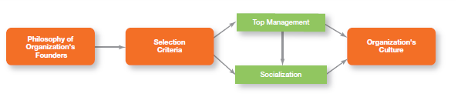
EXHIBIT 2-8 ESTABLISHING AND MAINTAINING CULTURE

Slide 19
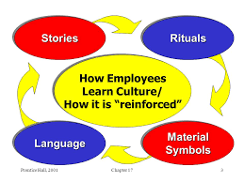
HOW DO EMPLOYEES LEARN CULTURE?
Stories - Narratives of significant events or people, e.g. organization founders, rule breaking, reaction to past mistakes etc.
Rituals - Sequences of activities that express and reinforce the important values and goals of the organization
Material Artifacts and Symbols - Convey the kinds of behavior that are expected, e.g. risk taking, participation, authority, etc.
Language - Acts as a common denominator that bonds members
Notes:
Employees “learn” an organization’s culture in a number of ways. The most common are stories, rituals, material symbols, and language. Organizational “stories” typically contain a narrative of significant events or people, including such things as the organization’s founders, rule breaking, reactions to past mistakes, and so forth. Managers at Southwest Airlines tell stories celebrating employees who perform heroically for customers.
Corporate rituals are repetitive sequences of activities that express and reinforce the important values and goals of the organization. One of the best-known corporate rituals is Mary Kay Cosmetics’ annual awards ceremony for its sales representatives. The company spends more than $50 million annually on rewards and prize incentives
When you walk into different businesses, do you get a “feel” for what type of work environment it is—formal, casual, fun, serious, and so forth? These reactions demonstrate the power of material symbols or artifacts in creating an organization’s personality. . Material symbols convey to employees who is important and the kinds of behavior (for example, risk taking, conservative, authoritarian, participative, individualistic, and so forth) that are expected and appropriate.
Over time, organizations often develop unique terms to describe equipment, key personnel, suppliers, customers, processes, or products related to its business. New
employees are frequently overwhelmed with acronyms and jargon that, after a short period of time, become a natural part of their language. Once learned, this language
acts as a common denominator that bonds members.

Slide 20

HOW DOES CULTURE AFFECT MANAGERS?
Cultural Constraints on Managers
Whatever managerial actions the organization recognizes as proper or improper on its behalf
Whatever organizational activities the organization values and encourages
The overall strength or weakness of the organizational culture
Notes:
Because an organization’s culture constrains what they can and cannot do and how they manage, it’s particularly relevant to managers. Such constraints are rarely explicit.
They’re not written down. It’s unlikely they’ll even be spoken. But they’re there, and all managers quickly learn what to do and not do in their organization.

Slide 21
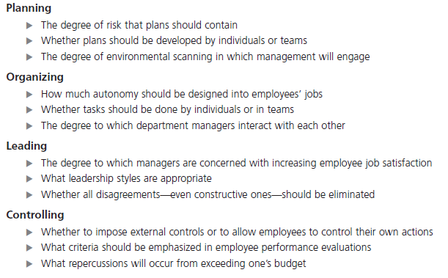
EXHIBIT 2-9 MANAGERIAL DECISIONS AFFECTED BY CULTURE

Slide 22


CREATING AN INNOVATIVE CULTURE
What does an innovative culture look like?
Challenge and involvement
Freedom
Trust and openness
Idea time
Playfulness/humor
Conflict resolution
Debates
Risk-taking
Notes:
In a recent survey of senior executives, over half said that the most important
driver of innovation for companies was a supportive corporate culture. What does an innovative culture look like? According to Swedish researcher Goran Ekvall, it would be characterized by the following:
Challenge and involvement—Are employees involved in, motivated by, and committed to long-term goals and success of the organization?
Freedom—Can employees independently define their work, exercise discretion, and take initiative in their day-to-day activities?
Trust and openness—Are employees supportive and respectful to each other?
Idea time—Do individuals have time to elaborate on new ideas before taking action?
Playfulness/humor—Is the workplace spontaneous and fun?
Conflict resolution—Do individuals make decisions and resolve issues based on
the good of the organization versus personal interest?
Debates—Are employees allowed to express opinions and put forth ideas for
consideration and review?
Risk-taking—Do managers tolerate uncertainty and ambiguity, and are
employees rewarded for taking risks

Slide 23
EXHIBIT 2-10 CREATING A CUSTOMER-RESPONSIVE CULTURE
How Do You Create a Customer Responsive Culture?
Hire the right type of employees (those with a strong interest in serving customers)
Have few rigid rules, procedures, and regulations
Use widespread empowerment of employees
Have good listening skills in relating to customers’ messages

Slide 24

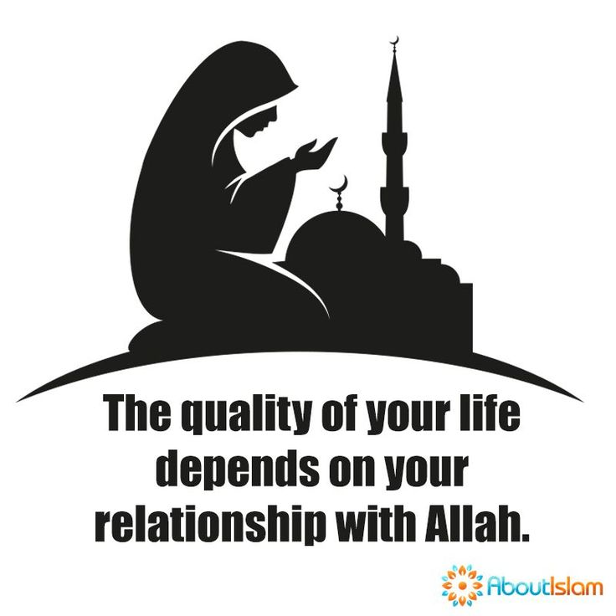

SPIRITUALITY AND ORGANIZATIONAL CULTURE
Workplace Spirituality - a culture where organizational values promote a sense of purpose through meaningful work that takes place in the context of community
Characteristics of a Spiritual Organization
Strong sense of purpose
Focus on individual development
Trust and openness
Employee empowerment
Toleration of employees’ expression

Slide 25



THE OMEGA TEST
Describe the two perspectives on how much impact managers have on an organization’s success or failure.

Slide 26

ANY QUESTION?

Slide 27

END OF LESSON

